Slide 1
Introduction to cyber-physical system modeling and verification
CS/ECE 584
Sayan Mitra
mitras@illinois.edu

Slide 2
Verification Problem .
System Model/Code & Property
Algorithm
or Method
Bug trace
Certificate
Verification. The action of demonstrating or proving to be true by means of evidence; formal assertion of truth. (OED)

Slide 3
Course Information
Lecture notes will be posted: https://wiki.illinois.edu/wiki/display/ECECS584FVECS/
(35%) 4-5 Homeworks, e.g.
specify systems; write proofs
verify using tools
(60%) Project
Today: some project ideas handed out; you can bring your own
In 1 month, project planning workshop (15 min 1-1 meeting)
Mid-September: Propose project (2 pages)
End of semester: Paper (10 pages) + presentation (15 mins)
(5%) Participation
Tools: PVS, SpaceEx, UPPAAL, C2E2
Webpage has links; start installing and browsing
Teaching Assistant: Nicole Chan nschan3@illinois.edu

Slide 4
State of Practice
How many miles must an autonomous car test drive before we call it safe?
200 million miles?
0.07 fatalities per billion passenger miles (commercial flight)
How is air-travel so safe?

Slide 5
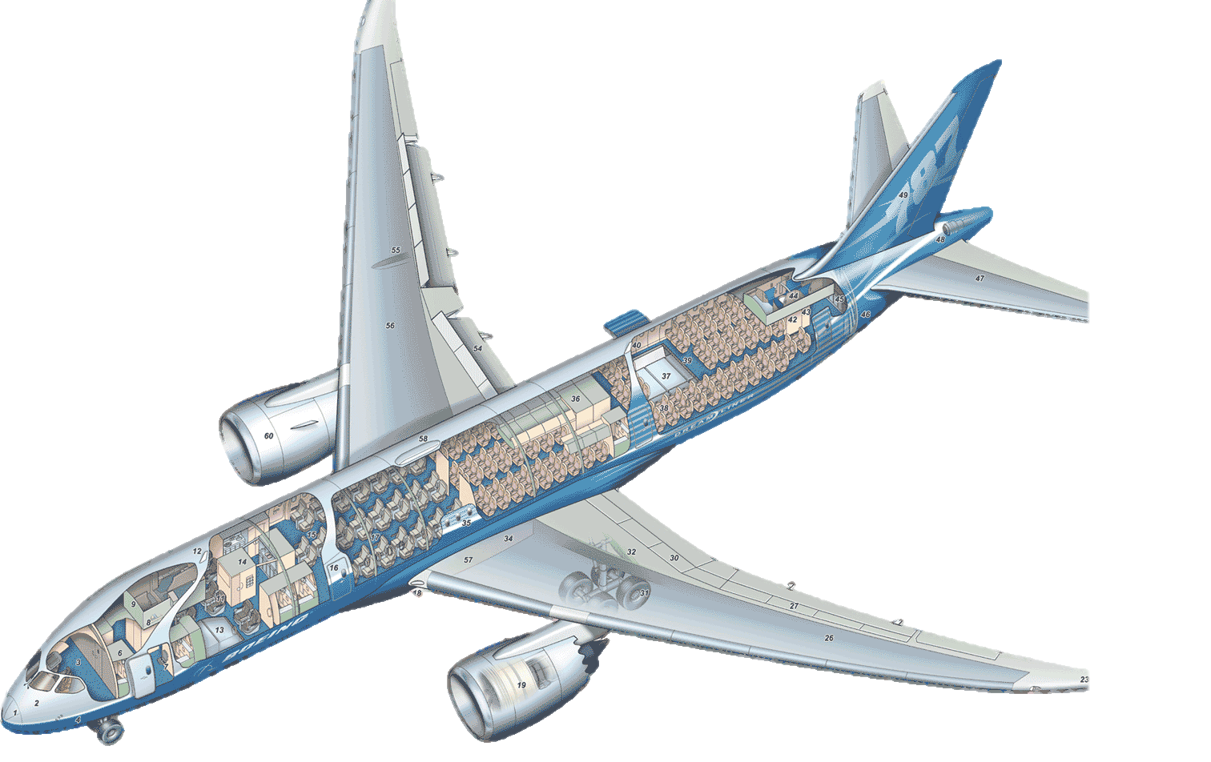

Regulations and Audits
What fraction of the cost of developing a new aircraft is in SW?
DO178C
Primary document by which FAA & EASA approves software-based aerospace systems.
DAL establishes the process necessary to demonstrate compliance
Supplement DDO178C
Dev.Assurance Level (DAL) | Hazard Classification | Objectives
A | Catastrophic | 71
B | Hazardous | 69
C | Major | 62
D | Minor | 26
E | No Effect | 0
Statement Coverage: Every statement of the source code must be covered by a test case
Condition Coverage: Every condition within a branch statement must be covered by a test case
Notes:
Today I will talk about verification of safety critical AE system of which the modern commercial airliner is probably the grandest example of.
Outset, we have to say that these air travel by a commercial airline is extremely safe by about every measure.
6” of leg space in an exit row is in high demand because the probability of being in a flight where the extra responsibility of being in an exit row would matter is very low.
The invisible hand that has made the safety record so impressive are the regulations that the US govt (and its European counterpart) puts in place for any airline to operate in the US airports.
From the phrasing of the safety announcements, to the weight of the cockpit door to # on board defibrillators, the FAA regulates no only the flying equipment but also the processes in the airports in countires from which the plane take off.
Part of this regularoy process that is relevant for my research is this document called DO178C by which FAA and EASA approve airbourne software
Categorizes into Levels
E.g., any software that commands, controls, and monitors safety-critical functions should receive the highest DAL - Level A.
Catastrophic - Failure may cause multiple fatalities, usually with loss of the airplane.
Hazardous - Failure has a large negative impact on safety or performance, or reduces the ability of the crew to operate the aircraft due to physical distress or a higher workload, or causes serious or fatal injuries among the passengers.
Major - Failure significantly reduces the safety margin or significantly increases crew workload. May result in passenger discomfort (or even minor injuries).
Minor - Failure slightly reduces the safety margin or slightly increases crew workload. Examples might include causing passenger inconvenience or a routine flight plan change.
No Effect - Failure has no impact on safety, aircraft operation, or crew workload.
The Airbus A320 jetliner, for example, a major product of the DO-178B era, contains a total of 800,000 lines of code in all of its avionics systems, points out Nat Hillary, field applications engineer with LDRA Software Technology, a software tool supplier in San Bruno Calif. By contrast the Boeing 777, a newer aircraft, features around 4 million lines of code.

Slide 6
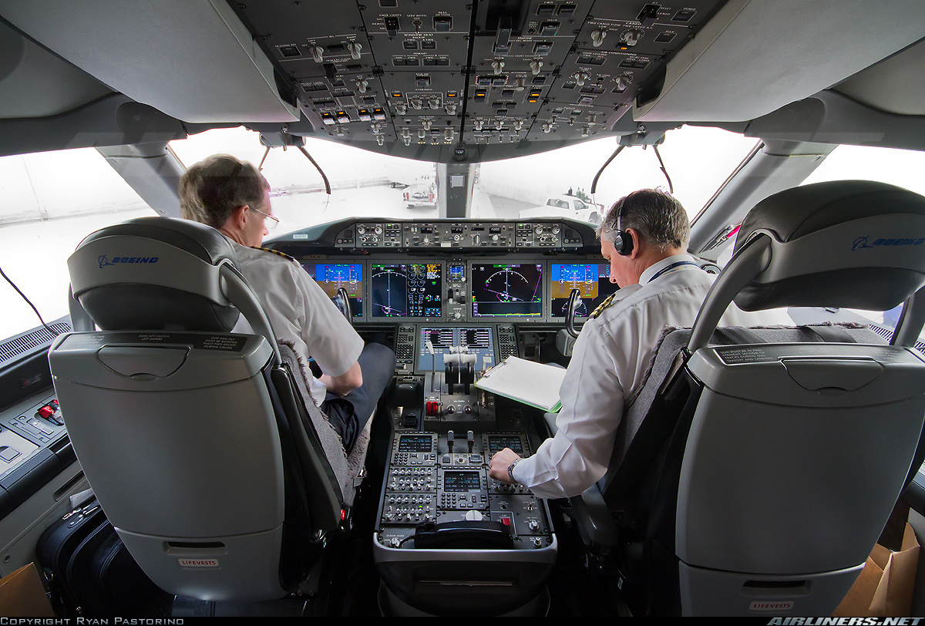
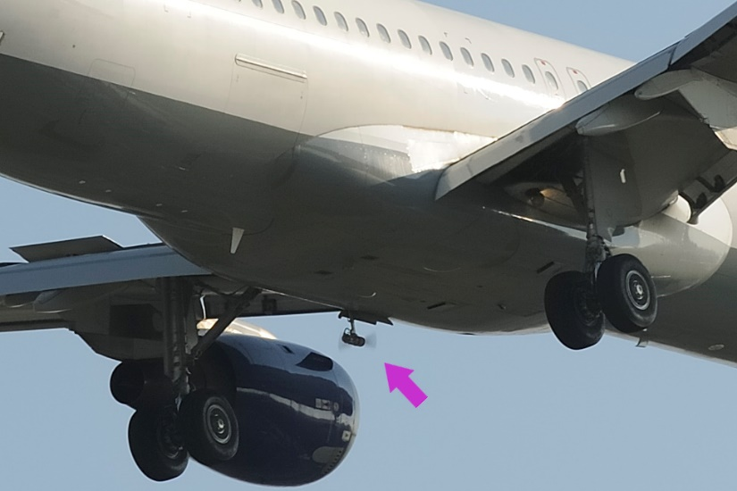
ZA002 Incident.
EVERETT, Wash., Nov. 10, 2010-- During approach to Laredo, Texas, yesterday, airplane ZA002 lost primary electrical power as a result of an onboard electrical fire. Backup systems, including the deployment of the Ram Air Turbine (RAT), functioned as expected and allowed the crew to complete a safe landing. The cause of the fire is still under investigation by Boeing.
Initial inspection appears to indicate that a power control panel in the aft electronics bay will need to be replaced on ZA002. We are inspecting the power panel and surrounding area near that panel to determine if other repairs will be necessary.
Boeing: Changes to Power Panel Design Nov. 24, 2010
Boeing has acknowledged the rumors circulating around that it was indeed FOD (foreign object damage) that had caused a short circuit that led to the fire in the P100 power panel. As a consequence Boeing will undertake a minor redesign of the power panel to reduce the chance of FOD creating and electrical arc or short circuit. Boeing will also implement software changes to make sure that power distribution is improved. This appears to be an acknowledgement that the electrical power redundancies failed as well.
New in DO178C
Formal Methods .
Model Based Development
Object Oriented Techniques
Notes:
Codifies best practices, but this is close gaps to guarantee safe software and as SW systems become more sophisticated the gaps are only going to become wider.
Many examples, but ZA002 incident which was one of the early testflights of the 787.
This plance lost primary power during the test flight.
For a plane with a fully electronic cockpit, loss of primary power, to the best of my understanding means that the cockpit goes dark.
Fortunately, this tiny tubine called the RAT Ram Air Turbine got deployed… powered up a separate electric supply circuit and the hydraulic system which ithen rebooted the system.
Boeing reported back that this was a combination of physical and sw failure. Foreign object damage … short circuit in one of the redundant power buses… but then the sw that was supposed to isolate the fault did not work either and tripped up the whole system.
So, the power system developed by Hamilton sunstrand / Honeywell probably passed through the certification process which, despite having been such a wonderful success, has left this design error uncovered until that fateful day.

Slide 7
Verification of CPS: We need standards, processes, tools, and trained individuals to ensure that algorithms meet the standards
Notes:
Hardware verification industry, example

Slide 8
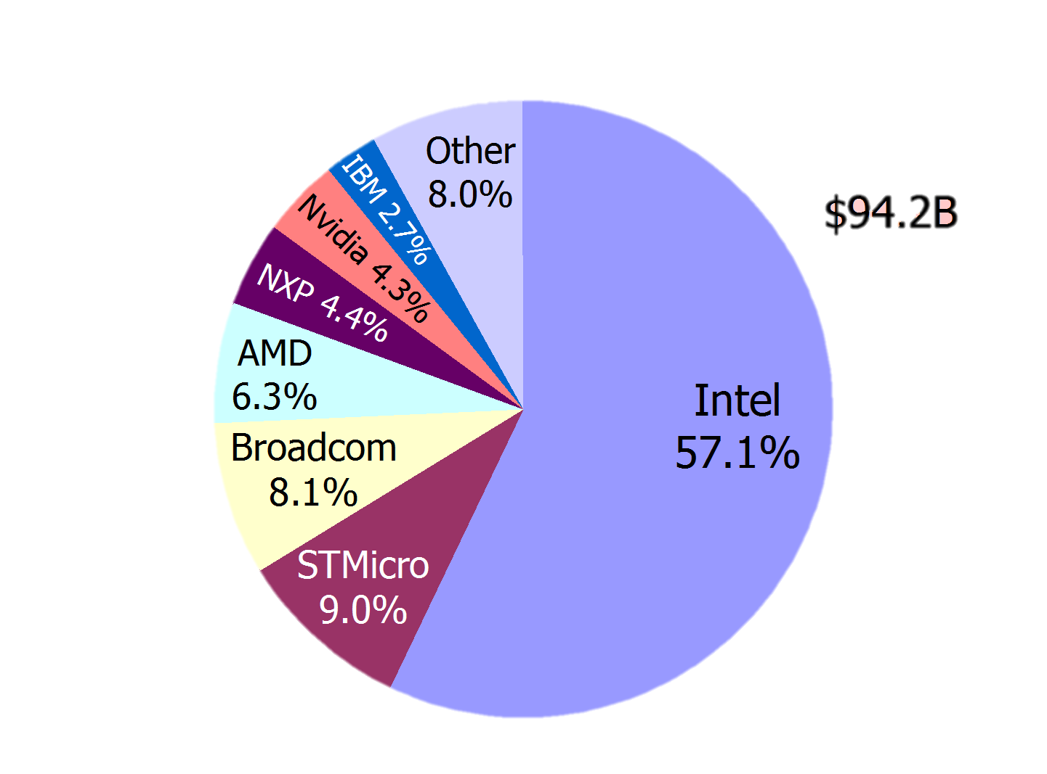
An earlier instance: microprocessor industry
Electronic design automation industry
Notes:
475m$ cost of replacing chips The Pentium FDIV bug was a computer bug that affected the floating point unit (FPU) of the early Intel Pentium processors. Because of the bug, the processor could return incorrect decimal results when dividing a number. Discovered in 1994 by Professor Thomas R. Nicely at Lynchburg College,^{[1]} Intel attributed the error to missing entries in the lookup table used by the floating-point division circuitry.^{[2]}

Slide 9
Defects become more expensive with time
cost of bug
time
How to Cut Software-Related Medical Device Failures and Recalls, Lisa Weeks

Slide 10
Design lifecycle
Define
Requirements
Vehicle
Calibration
System level
specification
System
Integration
Subsystem
Design in
Subsystem
Integration
Subsystem
Implementation

Slide 11
Beyond ECE/CS 584
Hardware verification (model checking) is now part of engineering practice in the industry
Automated Device Driver Verification at Microsoft: SLAM tool from MSR; AMAZON Web services verified using TLA
Formal modeling and analysis is becoming part of certification process for avionics (e.g., ASTREE); adoption for automotive and manufacturing around the corner
Commercial enterprises
Synopsis, Mentor Graphics, Cadence, Coverity, Galois, SRI, etc.
More up and coming in the automotive space
Vibrant research community:
Conferences: CAV, TACAS,HSCC, EMSoft
Faculty position openings
Related Turing Awards: Lamport (2014), Clarke, Sifakis & Emerson (2008), Pnueli (1997), Lampson (1992), Milner (1991), Hoare (1980), Dijkstra (1972) …

Slide 12
ECE/CS 584 Learning Objectives
Techniques for modeling systems with dynamics, computation, and communication
Hybrid Automata
Techniques for rigorously reasoning about correctness of systems
Techniques for using verification tools and libraries
model checkers, SMT solvers, and theorem provers
Exposure to some of the most influential ideas in CS and

Slide 13
Discrete Systems
Modeling

Slide 14
An Example: Informal Description
A token-based mutual exclusion algorithm on a ring network
Collection of processes send and receive bits over a ring network so that only one of them has a “token”
Discrete
Each process has variables that take only discrete values
Time elapses in discrete steps (This is a modeling choice and we can remove it later)

Slide 15
Token-based mutual exclusion in unidirectional ring Problem Specification
Legal
Illegal
Legal configuration = exactly one “token” in the ring
Single token circulates in the ring
Even if multiple tokens arise because of faults, if the algorithm continues to work correctly, then eventually there is a single token

Slide 16
Dijkstra’s Algorithm [‘74]
N processes: 0, 1, …, N-1
state of process j is x[j] ∈ {0, 1, 2, K-1}, where K > N
p₀ if x[0] = x[N-1] then x[0] := x[0] + 1
p_{j} j > 0, if x[j] ≠ x[j -1] then x[j] := x[j-1]
(p_{i} has TOKEN if and only if the conditional is true)

Slide 17
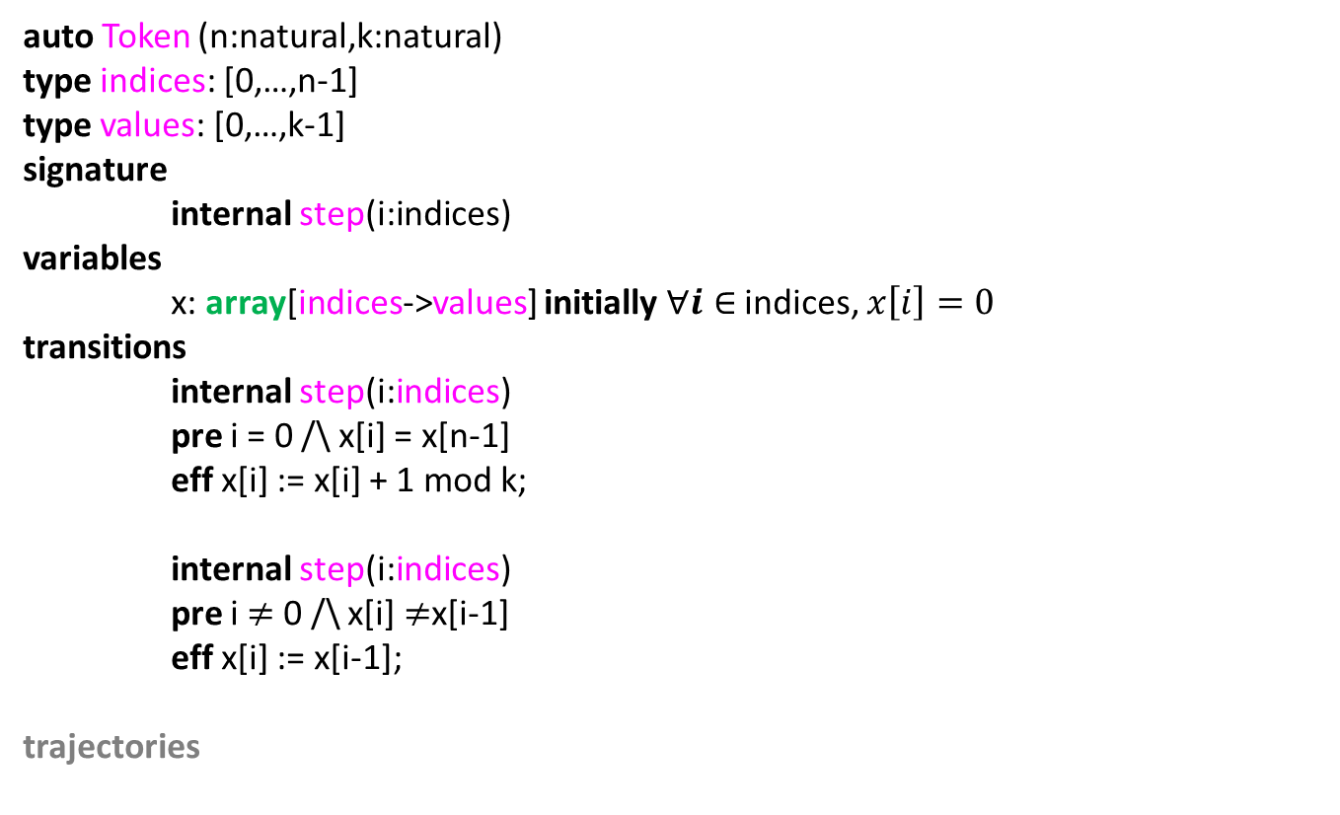
A Specification Language: HIOA
auto Token (n:natural,k:natural)
type indices: [0,…,n-1]
type values: [0,…,k-1]
signature
internal step(i:indices)
variables
x: array[indices->values] initially $∀i∈$ indices, $x\left[i\right]=0$
transitions
internal step(i:indices)
pre i = 0 /\ x[i] = x[n-1]
eff x[i] := x[i] + 1 mod k;
internal step(i:indices)
pre i $≠$ 0 /\ x[i] $≠$x[i-1]
eff x[i] := x[i-1];
trajectories

Slide 18
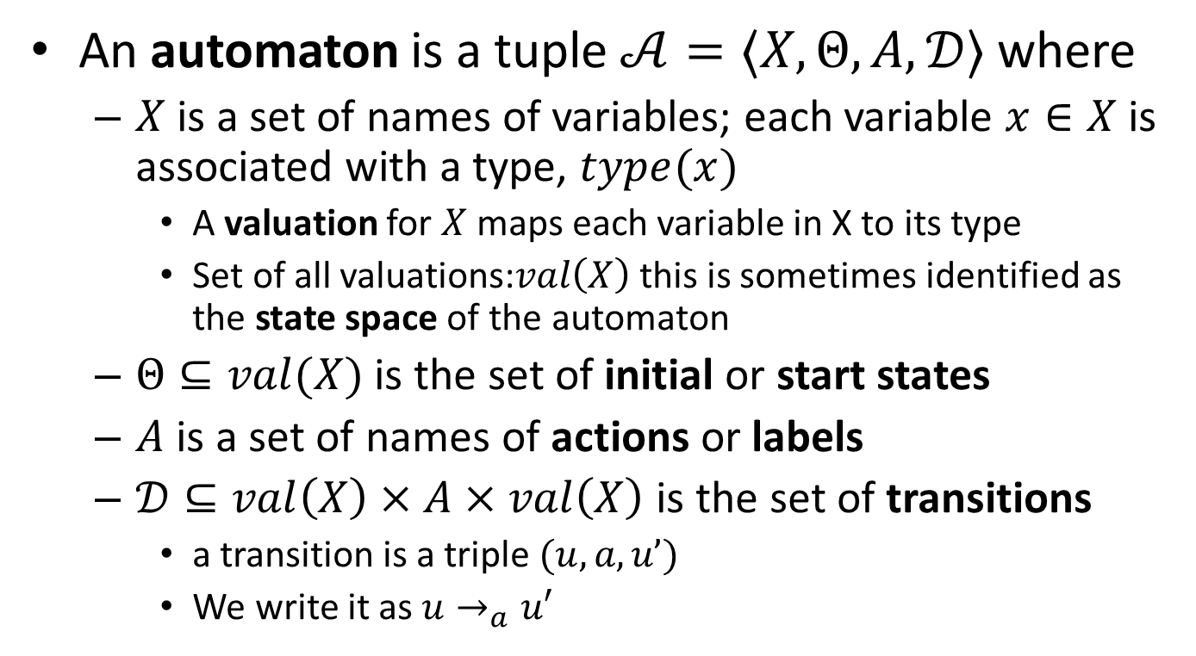
Discrete Transition System or Automaton
An automaton is a tuple $𝒜=〈X,Θ, A, 𝒟〉$ where
$X$ is a set of names of variables; each variable $x∈X$is associated with a type, $type(x)$
A valuation for $X$ maps each variable in X to its type
Set of all valuations:$val\left(X\right)$ this is sometimes identified as the state space of the automaton
$Θ⊆val(X)$ is the set of initial or start states
$A$ is a set of names of actions or labels
$𝒟⊆val\left(X\right)×A×val\left(X\right)$ is the set of transitions
a transition is a triple $(u,a,u’)$
We write it as $u→_{a}u′$

Slide 19
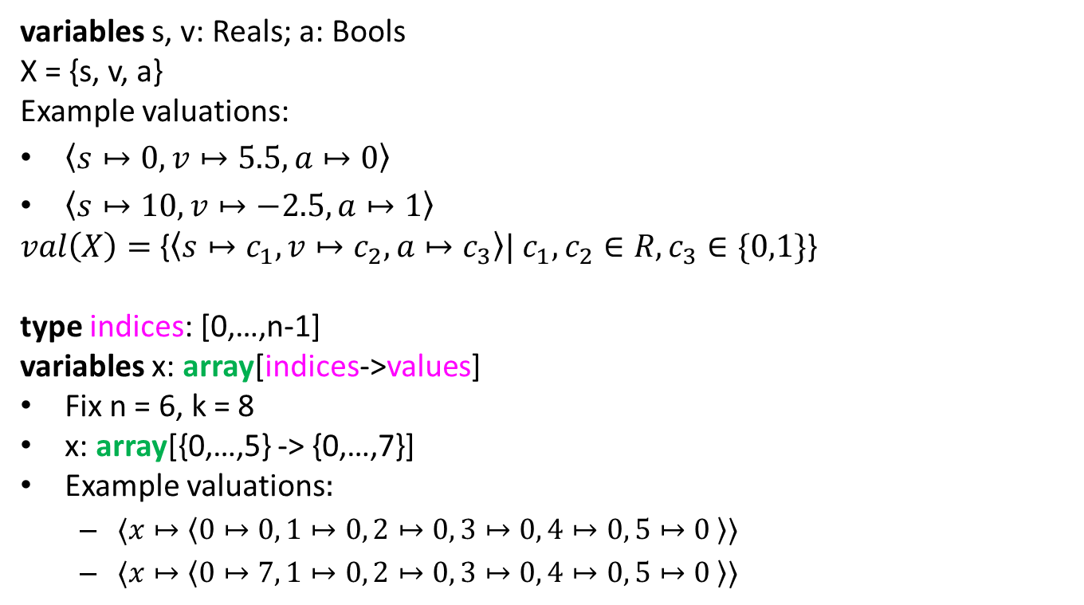
Well formed Specifications in IOA Language Define Automata: variables
variables s, v: Reals; a: Bools
X = {s, v, a}
Example valuations:
$〈s↦0, v↦5.5, a↦0〉$
$〈s↦10, v↦−2.5, a↦1〉$
$val\left(X\right)=${$〈s↦c_{1}, v↦c_{2}, a↦c_{3}〉| c_{1},c_{2}∈R, c_{3}∈\{0,1\}$}
type indices: [0,…,n-1]
variables x: array[indices->values]
Fix n = 6, k = 8
x: array[{0,…,5} -> {0,…,7}]
Example valuations$:$
$〈x↦〈0↦0, 1↦0, 2↦0, 3↦0, 4↦0, 5↦0 〉〉$
$〈x↦〈0↦7, 1↦0, 2↦0, 3↦0, 4↦0, 5↦0 〉〉$

Slide 20
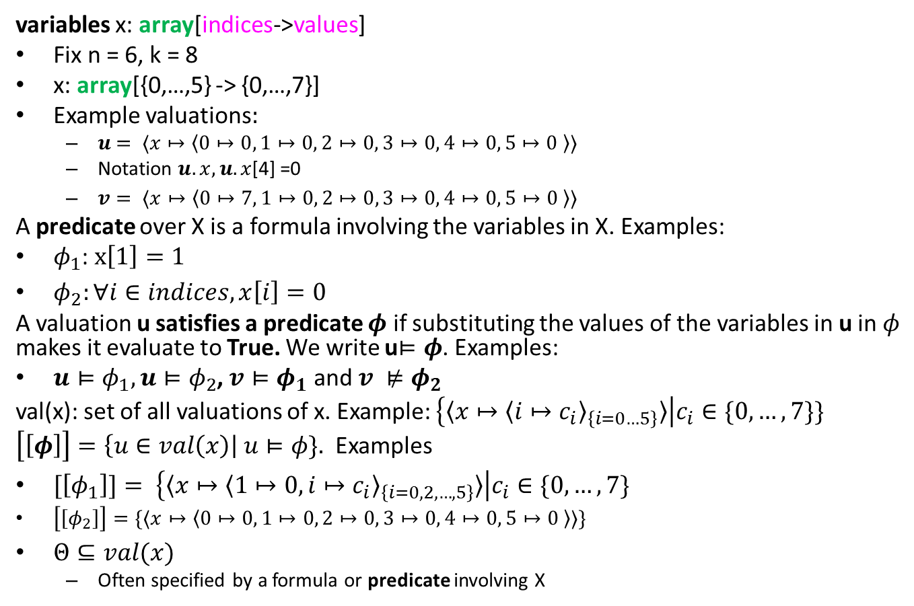
States and predicates
variables x: array[indices->values]
Fix n = 6, k = 8
x: array[{0,…,5} -> {0,…,7}]
Example valuations$:$
$u$ $= 〈x↦〈0↦0, 1↦0, 2↦0, 3↦0, 4↦0, 5↦0 〉〉$
Notation $u.x,u.x$[4] =0
$v= 〈x↦〈0↦7, 1↦0, 2↦0, 3↦0, 4↦0, 5↦0 〉〉$
A predicate over X is a formula involving the variables in X. Examples:
$φ_{1}$: $x\left[1\right]=1$
$φ_{2}:∀i∈indices, x\left[i\right]=0$
A valuation u satisfies a predicate $φ$ if substituting the values of the variables in u in $φ$ makes it evaluate to True. We write u$⊨φ$. Examples:
$u⊨φ_{1}, u⊨φ_{2}$, $v⊨φ_{1}$ and $v ⊭φ_{2}$
val(x): set of all valuations of x. Example: $\left\{〈x↦{〈i↦c_{i}〉}_{\left\{i=0…5\right\}}〉\right|c_{i}∈\{0,…,7\}\}$
$\left[\left[φ\right]\right]=\left\{u∈val\left(x\right)\right| u⊨φ\}.$ Examples
$[\left[φ_{1}\right]]= \left\{〈x↦{〈1↦0, i↦c_{i}〉}_{\left\{i=0,2,…,5\right\}}〉\right|c_{i}∈\{0,…,7\}$
$\left[\left[φ_{2}\right]\right]=\{〈x↦〈0↦0, 1↦0, 2↦0, 3↦0, 4↦0, 5↦0 〉〉\}$
$Θ⊆val(x)$
Often specified by a formula or predicate involving X

Slide 21
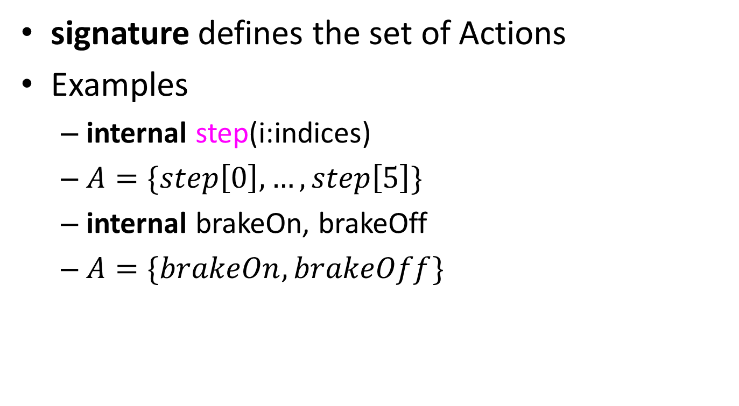
Actions
signature defines the set of Actions
Examples
internal step(i:indices)
$A=\{step\left[0\right],…,step\left[5\right]\}$
internal brakeOn, brakeOff
$A=\{brakeOn,brakeOff\}$

Slide 22
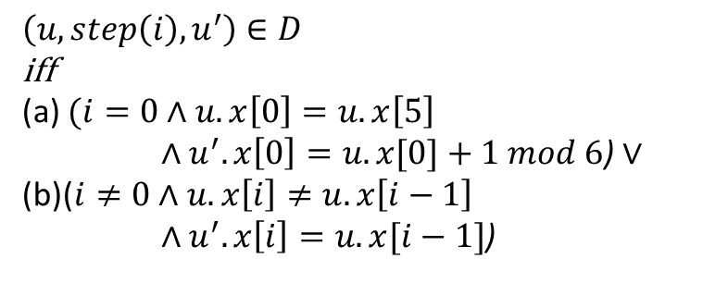
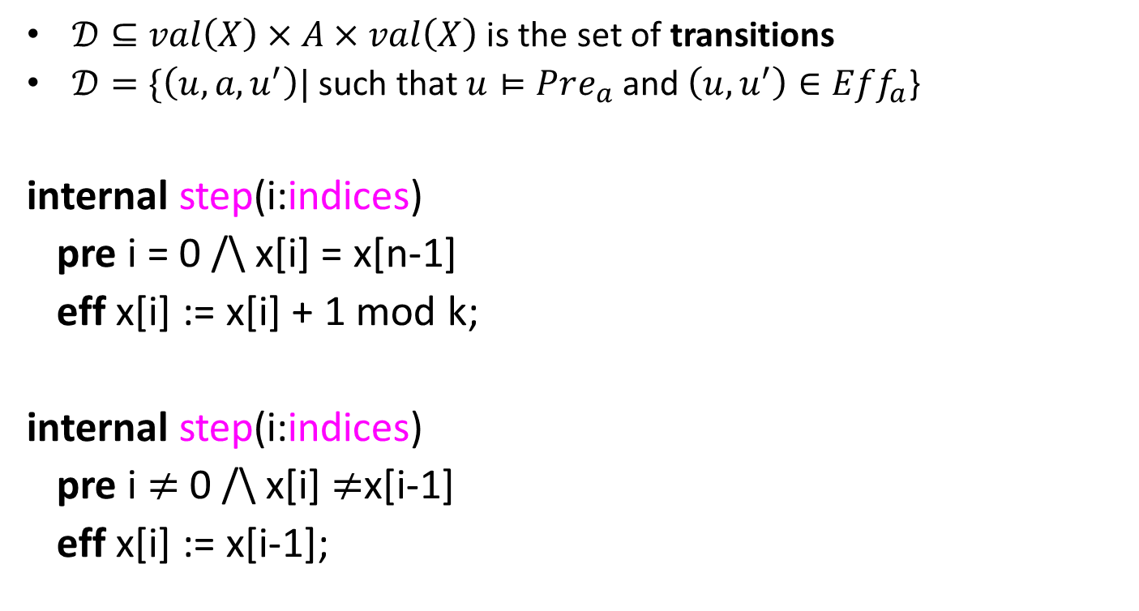
Transitions
$𝒟⊆val\left(X\right)×A×val\left(X\right)$ is the set of transitions
$𝒟=\{\left(u,a,u^{′}\right)|$such that $u⊨Pre_{a}$ and $\left(u,u^{′}\right)∈Eff_{a}$}
internal step(i:indices)
pre i = 0 /\ x[i] = x[n-1]
eff x[i] := x[i] + 1 mod k;
internal step(i:indices)
pre i $≠$ 0 /\ x[i] $≠$x[i-1]
eff x[i] := x[i-1];
$$\left(u,step\left(i\right),u^{′}\right)∈D$$
iff
(a) $(i=0∧u.x\left[0\right]=u.x\left[5\right]$
$∧u^{′}.x\left[0\right]=u.x[0]+1 mod 6$) $∨$
(b)($i≠0∧u.x\left[i\right]≠u.x\left[i−1\right]$
$∧u^{′}.x\left[i\right]=u.x[i−1]$)

Slide 23
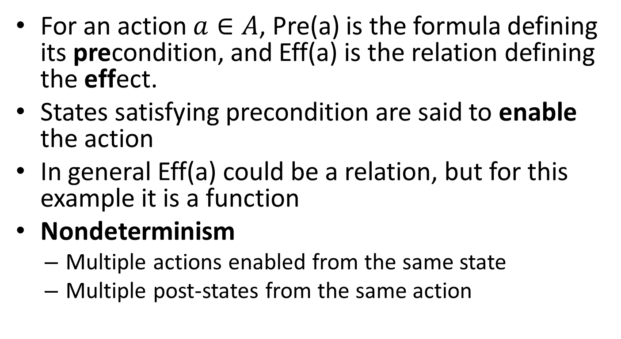
Nondeterminism
For an action $a∈A$, Pre(a) is the formula defining its precondition, and Eff(a) is the relation defining the effect.
States satisfying precondition are said to enable the action
In general Eff(a) could be a relation, but for this example it is a function
Nondeterminism
Multiple actions enabled from the same state
Multiple post-states from the same action

Slide 24
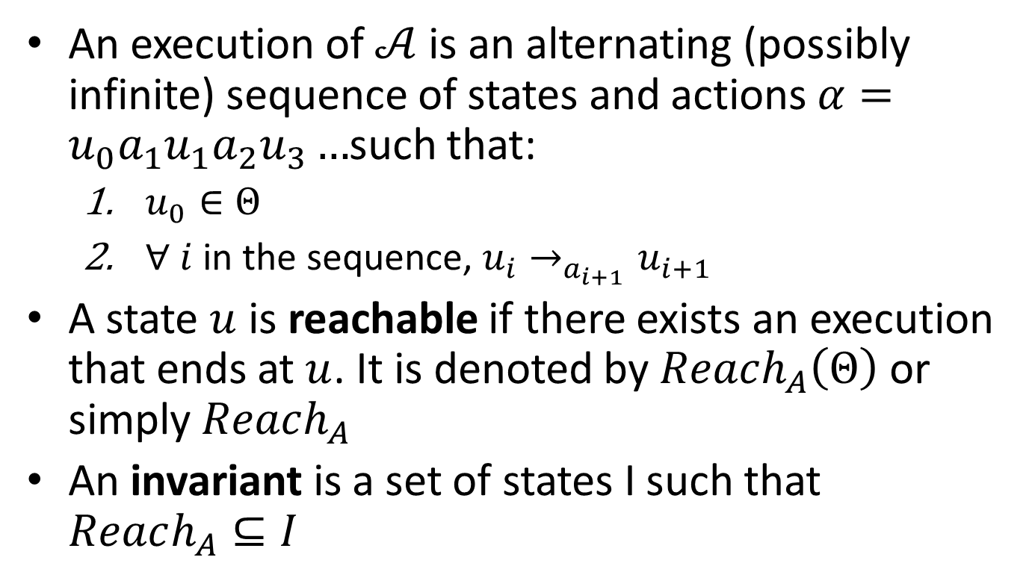
Executions, Reachability, and Invariants
An execution of $𝒜$ is an alternating (possibly infinite) sequence of states and actions $α=u_{0}a_{1}u_{1}a_{2}u_{3}…$such that:
$u_{0}∈Θ$
$∀ i$in the sequence, $u_{i}→_{a_{i+1}}u_{i+1}$
A state $u$ is reachable if there exists an execution that ends at $u$. It is denoted by $Reach_{A}\left(Θ\right)$ or simply $Reach_{A}$
An invariant is a set of states I such that $Reach_{A}⊆I$

Slide 25
Example Invariants for token Ring
“Exactly one process has the token”.
“At least one process has a token”.
“All processes have values at most k-1”.

Slide 26
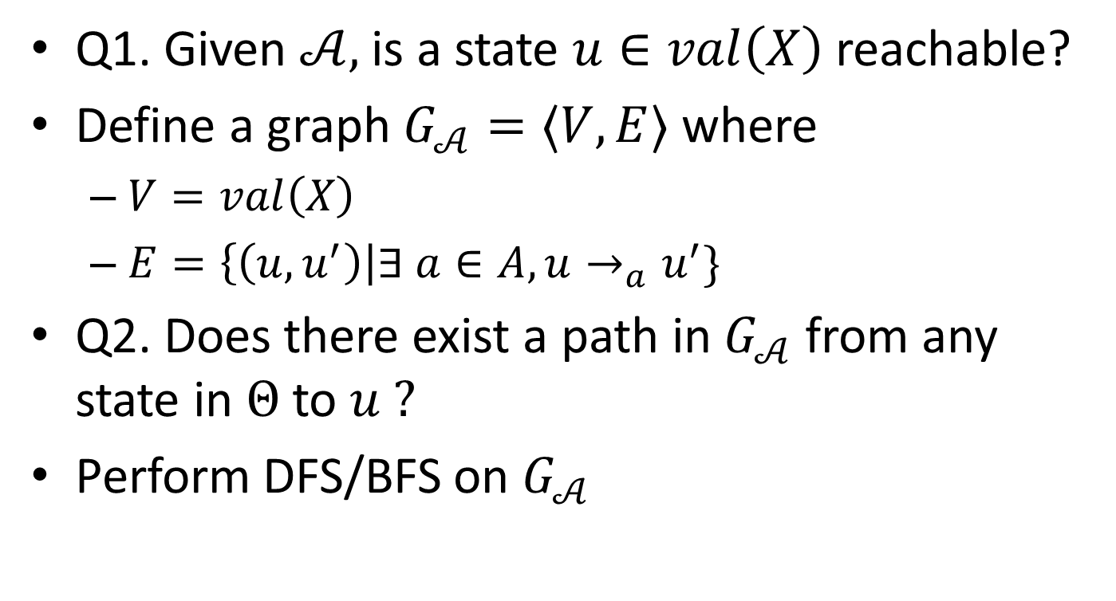
Reachability as Graph Search
Q1. Given $𝒜,$is a state $u∈val\left(X\right)$ reachable?
Define a graph $G_{𝒜}=〈V,E〉$ where
$V=val\left(X\right)$
$E=\left\{\left(u,u^{′}\right)\right|∃ a∈A, u→_{a}u^{′}\}$
Q2. Does there exist a path in $G_{𝒜}$ from any state in $Θ$ to $u ?$
Perform DFS/BFS on $G_{𝒜}$

Slide 27
Reach as fixpoint of Post?

Slide 28
Importance of Invariants

Slide 29

Reading Assignments
Next: Overview of complexity classes for understanding hardness of different verification problems
Reading assignment:
Turing Machines
Decidability
Complexity classes P, NP, PSPACE, NL
Reductions
Reference: Any standard textbook on theory of computation, e.g., Introduction to Theory of Computation by Michael Sipser

